Slide 1
CAST’s Depth and Breadth of Analysis

Slide 2
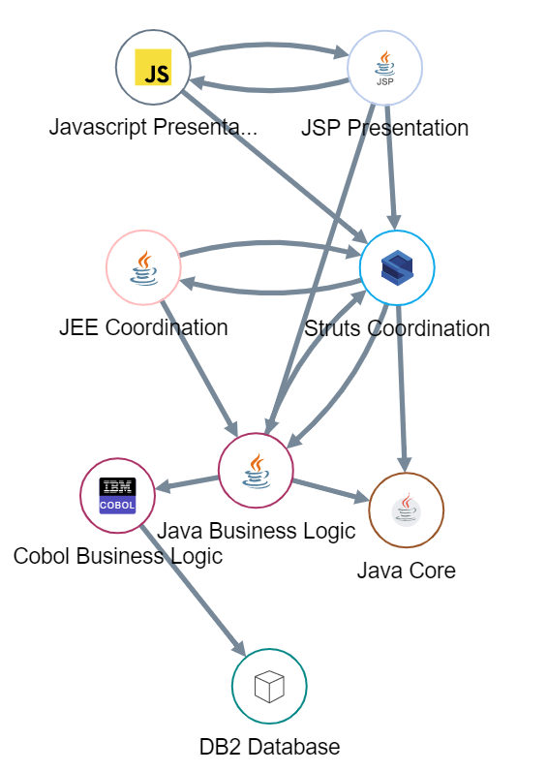







System-level vs. Line-level Code Analysis
Fundamental difference between CAST and SonarQube
CAST Application Intelligence Platform
SonarQube
Presentation Layer
Web, Mobile Apps
CAST System-level analysis models the flow across components and technology layers to analyze code the way an expert or an architect would.
Analogy : structure of the building
Sonar Line-level analysis examines each line or component individually to look for most common syntactical issues.
Analogy : quality of the bricks
Frameworks
System-level
Holistic, end to end analysis across the tech stack, including database and mobile apps
Unit-level
Without context of other components, no inter-dependencies
Business Logic
System-level flaws represent:
Only 8% of all defects
But 48% of the repair / rework efforts
And cause 90% of downtime / production issues
Data Layer Database
Scope of the analysis
“As organizations are under increasing pressure to accelerate software delivery, software code quality is no longer a "nice to have" but a necessity, hence the need for a system-level, architectural analysis of source code and applications' inner structure to deliver high-quality business applications.”

Slide 3

Rule Coverage Comparisons are Misleading Tick check boxes but neglect real world scenarios
Counting rules covered is superficial. A rule can (and should) be analyzed many different ways. We call these ”Scenarios”.
TECHNOLOGY
FRAMEWORK
IMPLEMENTATION
ACCURACY BOOST
Technology
Framework
Implementation
Accuracy Boost
Context Validation
# of Applicable Languages Supported (JEE, C#, C++)
Applicable Common Frameworks Supported (JDBC, Java EE Entity, Spring, Hibernate, JDO, Android Database, Angular)
+
# of Uncommon Frameworks Supported (MyBatis Framework Database access through MyBatis framework)
Different ways the solution addresses a standard. For example, ensuring that SQL injection is analysed from all angles including second order injection and NoSQL databases.
Additional accuracy checks via dataflow analysis, configurable thresholds, or increasing analysis granularity.
Provide contextual indicators of any finding’s validity. For example, understanding a call in a loop is invoking a second method that contains a SQL statement.
~ 50
~ 150
Dozens
~ 10
Hundreds

Slide 4



Depth of Coverage – CWE-89 SQL Injection
CWE-89: SQL Injection
Scenario |  | CAST | SonarQube
 | Technology | 6 JEE, C#, C++, SQL, MongoDB, DB2 | 2
 | Framework | 10 JDBC, Java EE Entity Manager, Spring Framework, Hibernate, JDO, Android Database, MyBatis, Angular, AngularJS, NodeJS | 1
 | Implementation | 4 Avoid SQL Injection Vulnerabilities Avoid 2nd Order SQL Injection Avoid NoSQL Injection Avoid Javascript String Interpolations | 1
 | Accuracy Boost | Use of Data Flow Analysis (reduce false positives, produce more accurate results in JEE, C#, C++)
 | Context Validation | Understand the risk of an entire transaction, tracing from front end entry points to backend end point regardless of how many methods are in the chain.
Total |  | 22 | 3
A query to the database is partly or completely constructed through the user inputs
The inputs need to be neutralized failing which the database queries could be completely altered by the users.
Example: A hacker can query the database to get all existing usernames and passwords
Reference:
CWE-89: Improper Neutralization of Special Elements used in an SQL Command ('SQL Injection’)
OWASP-A1:2017 – Injection
ASCSM-CWE-89: SQL Injection Improper Input
Neutralization

Slide 5
Depth of Coverage – CWE-772 Missing Release of Resource after Effective Lifetime
CWE-772: Missing Release of Resource after Effective Lifetime
Scenario |  | CAST | SonarQube
 | Technology | 7 JEE, C#, VB, Python, Cobol, SQL, DB2 | 3
 | Framework | n/a | n/a
 | Implementation | 5 Avoid missing release of SQL connection after an effective lifetime Avoid static Field of type collection Close database resources ASAP Close outer streams ASAP Avoid leaving open file resources | 1
 | Accuracy Boost | Reused or centralized resource release methods can be identified to boost accuracy of findings. Use system level to prioritize findings based on number of dependent objects.
 | Context Validation | Understand calls to routines that connect to resources even if method is 2 or more levels removed from original call or in a different language.
Total |  | 15 | 4
The software has a loop body or loop condition that contains a control element that directly or indirectly consumes platform resources, e.g. messaging, sessions, locks, or file descriptors.
It causes
Performance Lag
Data Corruption
Instability
Table Locking
Reference:
CISQ: ASCPEM-PRF-15,
ASCRM-CWE-772
ASCSM-CWE-772
CWE: CWE-404
CWE-772
CWE-1091
M7-2016

Slide 6
Depth of Coverage – CWE-1050 Excessive Platform Resource Consumption in Loop
CWE-1050: Excessive Platform Resource Consumption in a Loop
Scenario |  | CAST | SonarQube
 | Technology | 12 C#, VB, JEE, Python, COBOL, Siebel, Swift, Objective-C, PHP, EGL, SQL, HTML5, JavaScript ABAP | 4
 | Framework | 2 nodeJS, AngularJS
 | Implementation | 14 Avoid String Concatenation in Loops Avoid method invocation in loop termination expression Avoid the use of InstanceOf inside loops Avoid instantiations inside loops …and 10 more | 1
 | Accuracy Boost | Use system level analysis to prioritize findings based on number of dependent objects.
 | Context Validation | Understand calls to routines that connect to resources even if method is 2 or more levels removed from original call or in a different language.
Total |  | 28 | 5
The software has a loop body or loop condition that contains a control element that directly or indirectly consumes resources.
This issue can make the software perform more slowly.
An attacker can influence the number of iterations in the loop, then the performance problem might allow a denial of service by consuming more platform resources than intended.
Reference:
CISQ rule: ASCPEM-PRF-8
CWE 1050

Slide 7
CAST AIP’s Depth and Breadth of Analysis is Orders of Magnitude Greater
Due to CAST AIP’s ability to cover scenarios critical to managing enterprise software, its depth and breadth will generally be orders of magnitude larger. SonarQube’s scenario support for each CISQ quality area will range from a few to a few dozen, while CAST typically supports several hundred scenarios.
Security
Reliability
Performance Efficiency
Maintainability
Solution | CAST | SonarQube
Rules | 11 | 3
Scenarios | ‘00s | ‘0s
Solution | CAST | SonarQube
Rules | 15 | 8
Scenarios | ‘00s | ‘0s
Solution | CAST | SonarQube
Rules | 11 | 2
Scenarios | ‘00s | Few
Solution | CAST | SonarQube
Rules | 15 | 9
Scenarios | ‘00s | ‘0s
‘00s
‘00s
‘00s
'00s
‘0s
‘0s
‘0s
Few
CAST AIP
SonarQube
CAST AIP
SonarQube
CAST AIP
SonarQube
CAST AIP
SonarQube

